Slide 1
Email Cryptography
Kong Huang, Kevin Lin

Slide 2
Features
Securely send encrypted email messages
Protect messages from various cryptographic and network attacks
Easy to use user interface

Slide 3
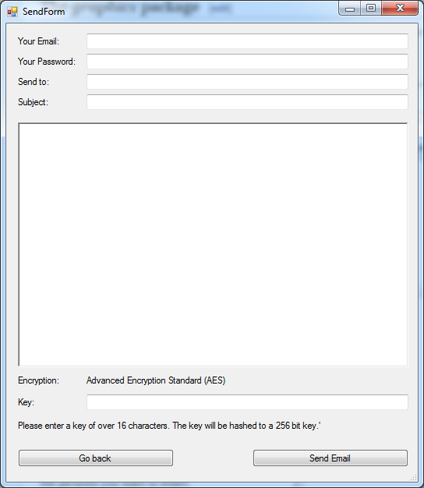
Design
Form for sending
Requests user info
Requires an encryption key of over 16 character length

Slide 4
Design
Symmetric-key encryption is used for message encryption
User provided key is hashed and salted using SHA-256
The resulting 256 bit key is then used in AES-256 encryption algorithm to encrypt the message

Slide 5
Design
Email is formatted after encryption to let the other user know they are receiving an encrypted message
Transmission is handled through TLS

Slide 6
How SSL/TLS works
Encrypted session uses TLS 1.2, following normal TLS handshake protocol

Slide 7
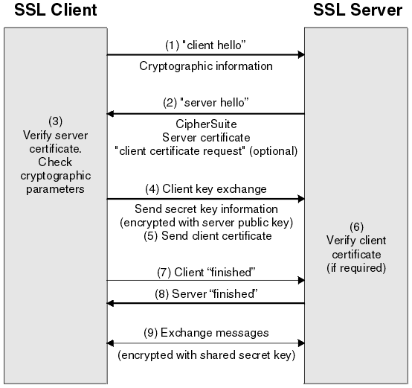
How SSL/TLS works

Slide 8
Attacks and their defenses
Data Eavesdropping
How it works: An attacker intercepts communications between two points mid transit
Our Defense: TLS encrypts the transmissions so the contained data cannot be eavesdropped
However, it does not protect against attacks against the endpoints
Ex. bugs in the used TLS stacks, buffer overflows, or bugs in application logic (cross site scripting)

Slide 9
Attacks and their defenses
Data Modification
How it works: An attacker modifies data in the packet without the knowledge of the sender or receiver
Our Defense: Since transmission is encrypted, data cannot be modified without the message becoming invalid
Standard TLS protocol uses HMACS (keyed-hash message authentication codes)
Attacker needs to know the secret and the message (amongst others) to modify the email (which is impossible given the public key infrastructure in TLS)
As such, attacker can only modify the message arbitrarily, causing the server to deem the email invalid

Slide 10
Attacks and their defenses
Data Replay
How it works: An attacker maliciously or fraudulently repeats or delays a valid data transmission.
Our Defense: TLS channel itself is protected against replay attacks using the HMAC in the same fashion as stated in the previous section.
In addition, TLS requires the client and server to exchange a nonce in the hello message.
The nonce is never repeated in order to prevent the replay attacks.

Slide 11
Attacks and their defenses
Masquerade Attacks/Identity Spoofing
How it works: An attacker masquerades as another by falsifying data and gaining an illegitimate advantage.
Our Defense: TLS authenticates all parties and encrypts all traffic.
TLS prevents an attack from performing IP address spoofing on a specific connection (for example, mutual TLS connections)
However, an attacker can still spoof the address of the DNS server

Slide 12
Attacks and their defenses
Man-in-the-Middle Attack
How it works: An attacker places himself in between a client and server, impersonating both. All traffic passes through this man-in-the-middle, who is able to read and modify any of the data.
Our Defense: The certificate authority (CA) system is designed to stop this kind of attack.
The server uses the private key associated with their certificate to establish a connection (and keeps this key secret)
Attacker has to convince a CA to sign their own certificate, and a certificate that is not validated by a known trusted CA will be caught immediately
A corrupted CA can still compromise the message. However, our message is encrypted with AES-256 before being sent out, so it is still reasonably secure.

Slide 13
Attacks and their defenses
Compromised-Key Attack
How it works: An attacker determines the key, and uses the key to decrypt encrypted data without the knowledge of the sender of the data
Our Defense: Depending on the key, the message is still secure based on several factors.
AES encryption scheme key gets compromised
Security relies on the recipient’s email service as the attacker requires access to the encrypted message
Shared secret key used in the TLS is compromised
Nothing can be determined in reasonable time as message will be encrypted with solely an AES scheme or with an AES scheme and the scheme chosen through the TLS protocol
If both keys are compromised, the attacker could intercept the encrypted message as it is being sent and decrypt it twice

Slide 14
Questions?

